Slide 1
Building Energy Consumption Classification
Dr. Lewe
Kunal Sharma
Georgia Institute of Technology
AREOspace Design Lab

Slide 2

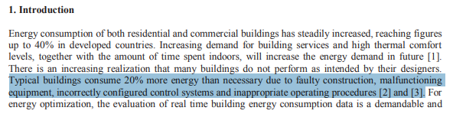
Problem Statement
“Typical Buildings Consume 20% more energy than necessary due to faulty construction, malfunctioning equipment, incorrectly configured control systems and inappropriate operating procedures.” – Mediterranean Green Energy Forum

Slide 3
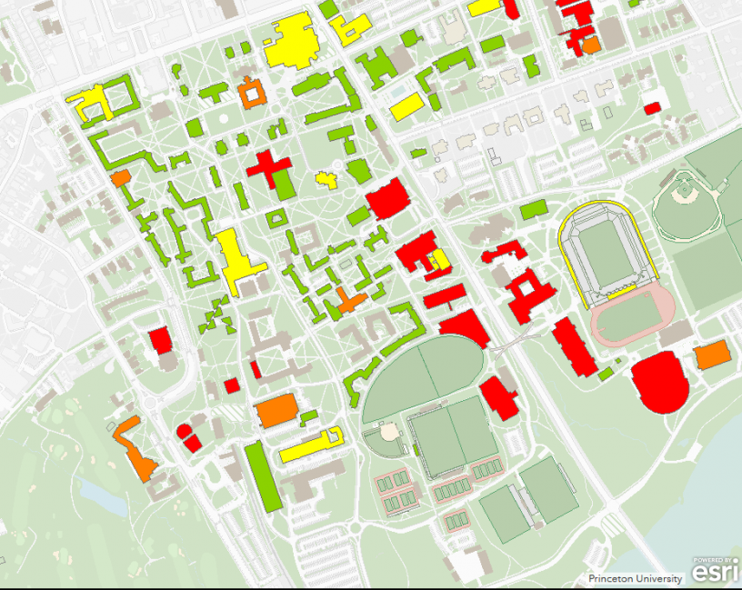
Objective
Goal: Detect abnormal cases of energy usage of the 137 buildings on the Georgia Tech campus by classifying daily building energy consumption.
Abnormal Cases May Detect:
Energy Mismanagement
Overconsumption
Electric Issues

Slide 4
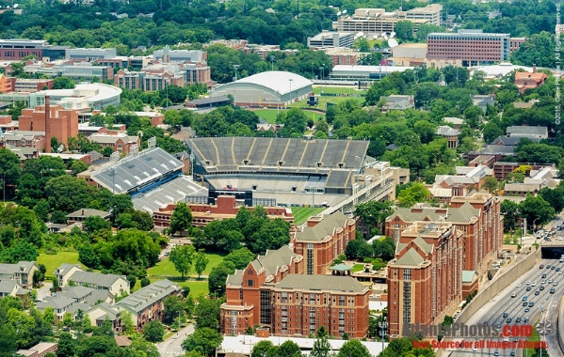

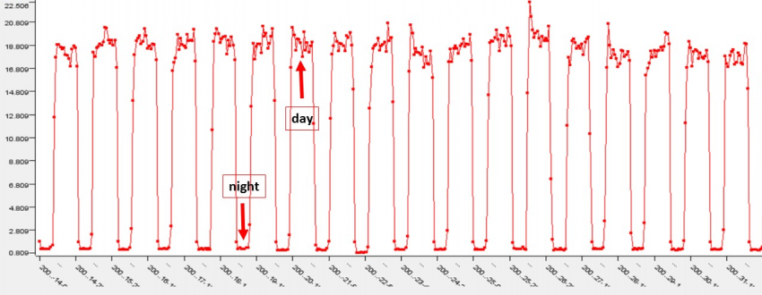
Data Collection
Energy Used by 134 Campus Buildings
Data Stored in Servers
Energy Data Used for Classification

Slide 5
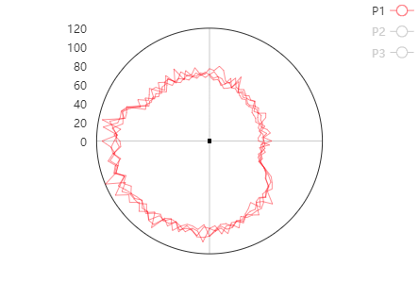
Methodology
To classify a building’s energy behavior we will consider its energy “fingerprint”.
The fingerprint is a polar plot of the energy usage of a building over 24 hours, plotted in 15 min intervals.
Building Energy Consumption

Slide 6
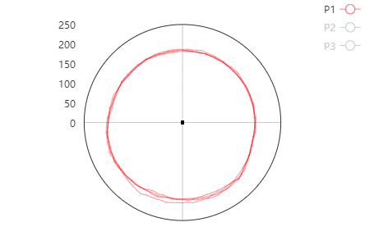
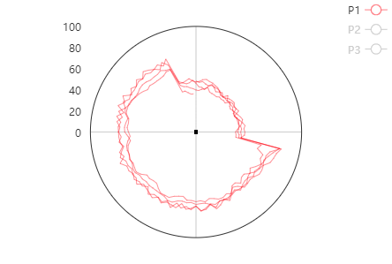
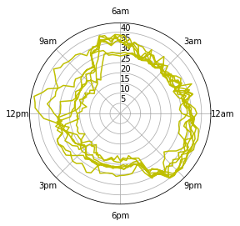
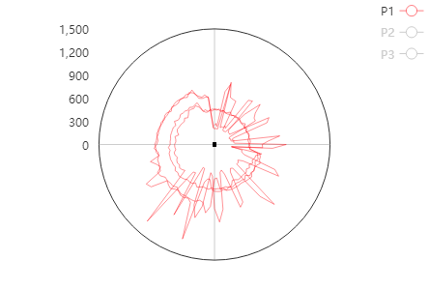
Classification Types
Concentric
People
Scheduler
Reverse
Random
Building’s energy consumption is relatively constant throughout the day
Building uses more energy during work hours likely due to energy consumption by people.
Building uses scheduler machine. Sudden jumps and drops in energy usage at set time periods.
Building energy usage during non-work hours is much greater than the energy usage for the rest of the day.
Building energy behavior that is abnormal and does not have a clear pattern.

Slide 7
Data Labelling
Machine learning algorithms perform well on pattern recognition (classification) problems given sufficient examples.
2,926 energy signatures were manually labelled for training purposes.
Building Type: Scheduler

Slide 8
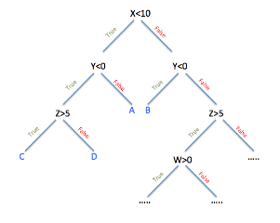
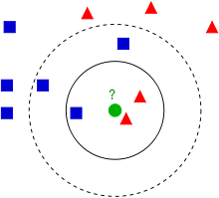
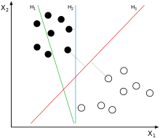
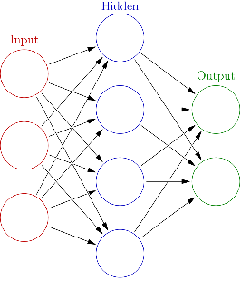
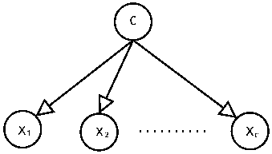
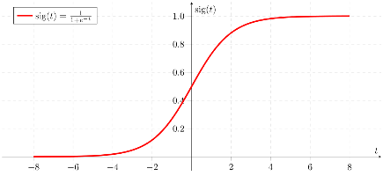
Model Selection
Initially, 7 Machine Learning models were selected for classification.
Decision Trees
K Nearest Neighbors
Support Vector Machine
Random Forest
Naïve Bayes
Artificial Neural Network
Logistic Regression

Slide 9
Data Labelling
Machine learning algorithms perform well on pattern recognition (classification) problems given sufficient examples.
2,926 energy signatures were manually labelled for training purposes.
Building Type: Scheduler

Slide 10
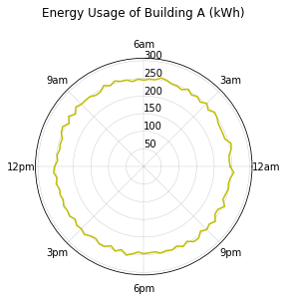
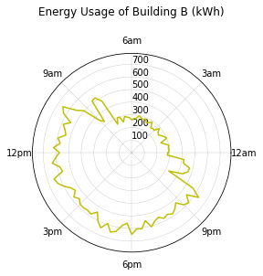
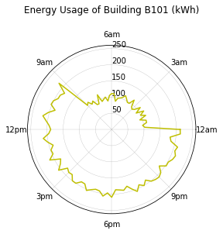
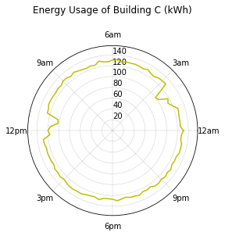
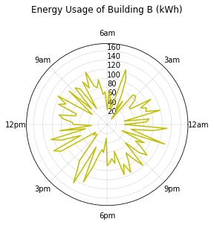
Artificial Data Generation
Generated functions that create artificial data to look similar to the original.
The random forest classifier achieved a 98.7% accuracy in classifying artificial data but only achieved a mere 7% accuracy when classifying real instances of classes.
Randomly generated plots do not accurately represent the true variation in the data.
Concentric
People
Scheduler
Reverse
Random

Slide 11
Data Manipulation (Rotation)
We multiplied the dataset size by “rotating” or changing the time of each consumption record.
Rotated by some multiple of 15 mins between 2 hours before to 2 hours after the time of the original data.
This method improved the accuracy by about 2%.
Data Rotations
Backward Rotation
Original
Forward Rotation

Slide 12
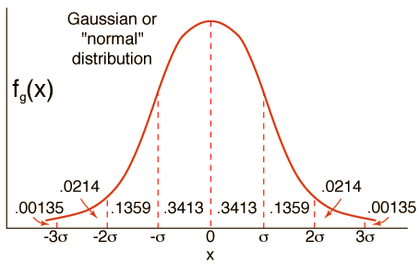
Data Manipulation (Adding Noise)
To create even more data we tried multiplying every 15 minute data point by a small number to create a slightly different energy signature.
However, this decreased the accuracy by 3% likely because it only added noise to the data.
Data became distorted, losing the nuances in the data that were key to classification.
Added Noise is Normally Distributed

Slide 13
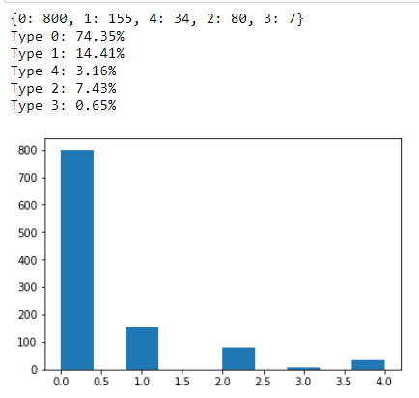
Unbalanced Dataset
It was difficult to evaluate the performance of the models because the data was heavily unbalanced.
The overwhelming majority of samples were “Concentric” or “People”.
Training Data Type Distribution
Distribution
Count
Type

Slide 14
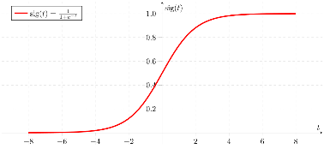
Highest Performing Models
68%
86%
38%
88%
43%
86%
41%
Decision Trees
K Nearest Neighbors
Support Vector Machine
Random Forest
Naïve Bayes
Artificial Neural Network
Logistic Regression

Slide 15
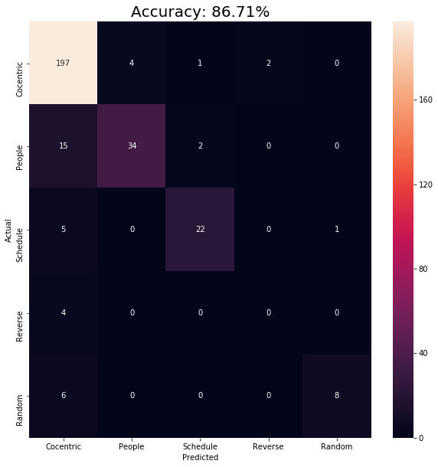
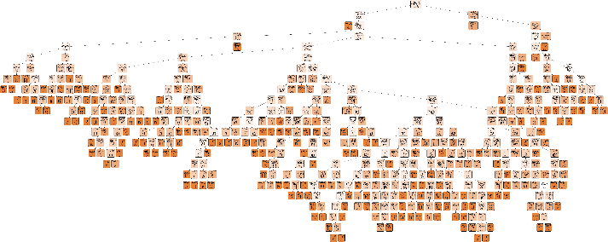
Random Forest: Accuracy 86.71%
Confusion Matrix
Sample Decision Tree Complexity

Slide 16

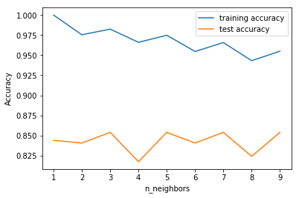
K Nearest Neighbor: Accuracy 85.38%
Confusion Matrix
Accuracy for Various K Values

Slide 17
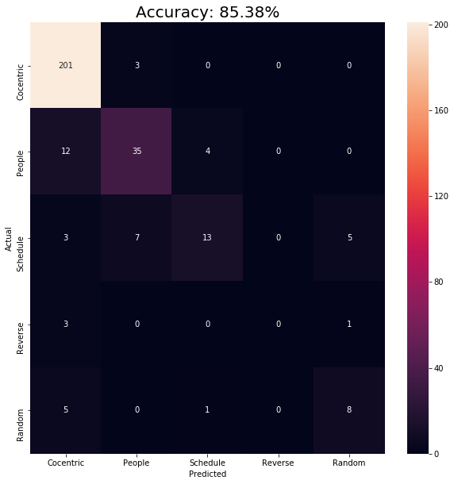
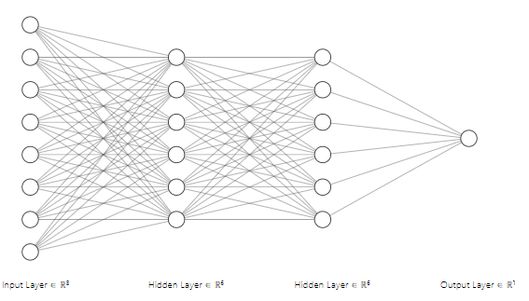
Artificial Neural Network: Accuracy 85.38%
Confusion Matrix
Neural Network Architecture: [96, 30, 20, 10, 8, 5]

Slide 18
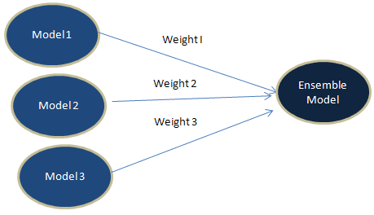
What is an Ensemble Model?
An ensemble model combines several base models in order to produce one optimal predictive model.
One of the ways this can be implemented is with a voted weighted average.

Slide 19

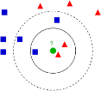
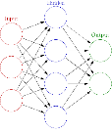
Ensemble Model: Accuracy 89.04%
Confusion Matrix
Voting Model
Accuracy
Ensemble
Classifier
Random Forest
K Nearest Neighbor
Artificial Neural Network
Algorithm | Accuracy
Ensemble Classifier | 89.04%
Random Forest | 86.71%
KNN | 85.38%
ANN | 85.38%

Slide 20
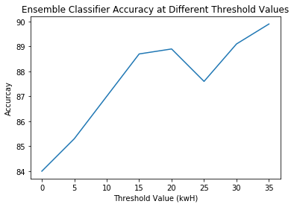
Data Filtered By Threshold (kwH)
Since small buildings were found to behave erratically, they were removed from the dataset at different thresholds.
At a threshold of 150kwH the accuracy achieved is 90.21%.

Slide 21
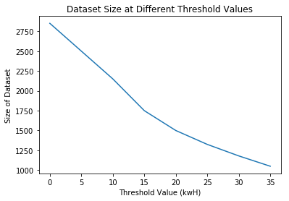
Filtering Effect on Dataset Size
As expected the size of the dataset decreases as the threshold increases.

Slide 22
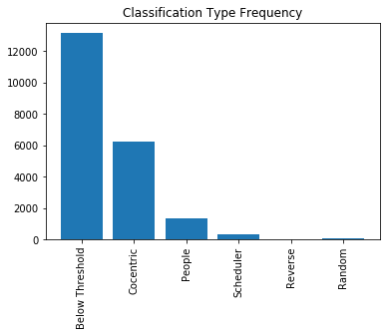
Classifying the Dataset
We can use the classification model to classify the energy consumption of 133 buildings over an 8 month period (Jan – Aug 2018).
Classification Type Frequency
Below Threshold (30kwh) | 13,157
Concentric | 6,259
People | 1,333
Scheduler | 341
Reverse | 5
Random | 77
Total | 21,172

Slide 23
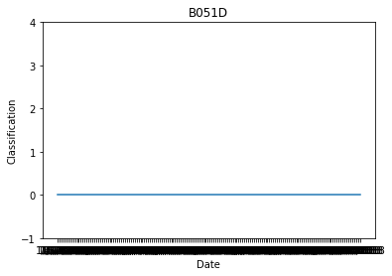
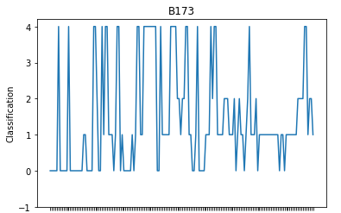
Case Study: B051D, B173
Building B051D is an example of a building that is consistently classified as 0 (Concentric).
In contrast, building B173 continuously changes classification throughout the 8 months.

Slide 24

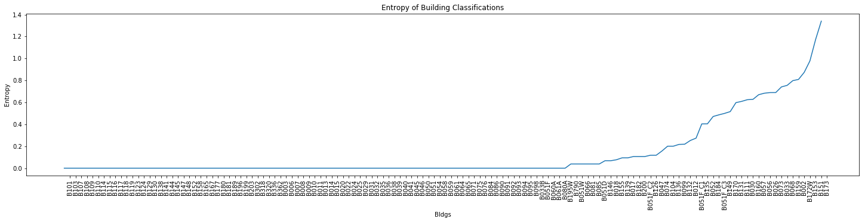
Using Entropy to Rank Building Volatility
Entropy can calculate how mixed a set is. We can calculate the entropy of buildings and rank them.
Entropy Equation

Slide 25

Using Entropy to Visualize Volatility
We can visualize the entropy of buildings overtime.
The heatmap on the right allows us to quickly identify buildings with the most volatility in energy consumption behavior.

Slide 26
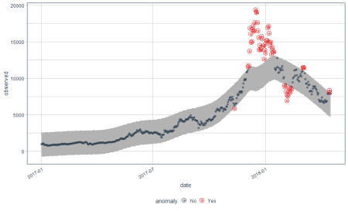
Closing Remarks
Ensemble Machine Learning models can effectively classify time series energy data.
If this project was repeated, more time would be spent on initial data exploration for clearer definition of classification prototypes.
More specific classifiers can be developed to the classify below-threshold buildings filtered out of classification.
Regression models and statistical techniques can be applied to identify anomalies and predict energy usage.

